Slide 1
Data Pre-processing: Intro and Integration
Anran Zhao
Research Associate at UK Data Service
Email: anran.zhao@manchester.ac.uk
Notes:
Hello! My name is Dr. Julia Kasmire and I work in the Computational Social Science Training Team with the UK Data services. BLAH BLAH BLAH

Slide 2
Can you hear us?
?
Notes:
You should see a poll on your screen around about now. And if you can answer whether you can hear us or not…
Yes
No

Slide 3
Can you hear us?
If not:
Check your speaker/headset is plugged in / volume is on.
Click on audio to change to listening via phone
We are recording this webinar and will post it on YouTube (https://www.youtube.com/user/UKDATASERVICE)
Notes:
You should see a poll on your screen around about now. And if you can answer whether you can hear us or not…
Yes
No

Slide 4
Data Pre-processing: Intro and Integration
Anran Zhao
Research Associate at UK Data Service
Email: anran.zhao@manchester.ac.uk
Notes:
Hello! My name is Dr. Julia Kasmire and I work in the Computational Social Science Training Team with the UK Data services. BLAH BLAH BLAH

Slide 5
Table of Content
Definition, context, and collecting data
Data integration (join tables)
Data cleaning (missing values, outliers, data types)
Data reduction (correlation check and PCA)
Data transformation (normalisation and one-hot encoding)
Notes:
There’s two talks and one code demonstration on this topic. One talk on today and another one on next Thursday. Today we are going to cover the xx, xx and xx. As well as data integration, mainly on joining tables, and also briefly on data linkage and data enrichment.
Next Thursday, we are going to cover more on xx such as xx, xx, and xx. All these are very common tasks in data preprocessing. On the Thursday after next Thursday we are going to deliver a live-streaming code demonstration on Youtube. We are going to provide some sample python codes and perform these tasks. If you are interested in these, you are very welcomed to join the next two sessions. Also if you want to know more about this topic or any specific part that I didn’t mention, we are going to send a questionnaire after the talk and please leave your comments there to help us improve.
Also, although we cannot hear you during the talk, we’ll have a Q&A session later and answer the questions. Meanwhile you are welcomed to leave your questions in the Q&A box throughout the talk, my colleague Julia will answer it directly there, if it’s not too complicated. Or she might leave it to the Q&A session so don’t worry.

Slide 6
Data Pre-processing
Data pre-processing (a.k.a. data preparation) is the process of manipulating or pre-processing raw data from one or more sources into a structured and clean data set for analysis. It is an important part of Data Analytics.
Data pre-processing includes various tasks and considerations, e.g.
- Selecting and acquiring data to use
- Integrating different data sources together
- Conducting exploratory analysis
- Cleaning and repairing data, e.g., missing data, inconsistent data
- Data reduction, transformation, etc.
Notes:
Ok. Without further due, let me give you a definition of data preprocessing. Data pre-processing (a.k.a. data preparation) is the process of manipulating or pre-processing raw data from one or more sources into a structured and clean data set for analysis. It is an important part of Data Analytics. When the data has been fully prepared, it is then ready for further analysis like classification, association, prediction, and clustering of data
There’s no clear recipe or standard for data preprocessing. Usually it includes various tasks and considerations, e.g.
- Selecting and acquiring data to use
- Integrating different data sources together
- Conducting exploratory analysis
- Cleaning and repairing data, e.g., missing data, inconsistent data
- Data reduction, transformation, etc.
Generally speaking, it can be regarded as everything you do before the actual modelling.

Slide 7
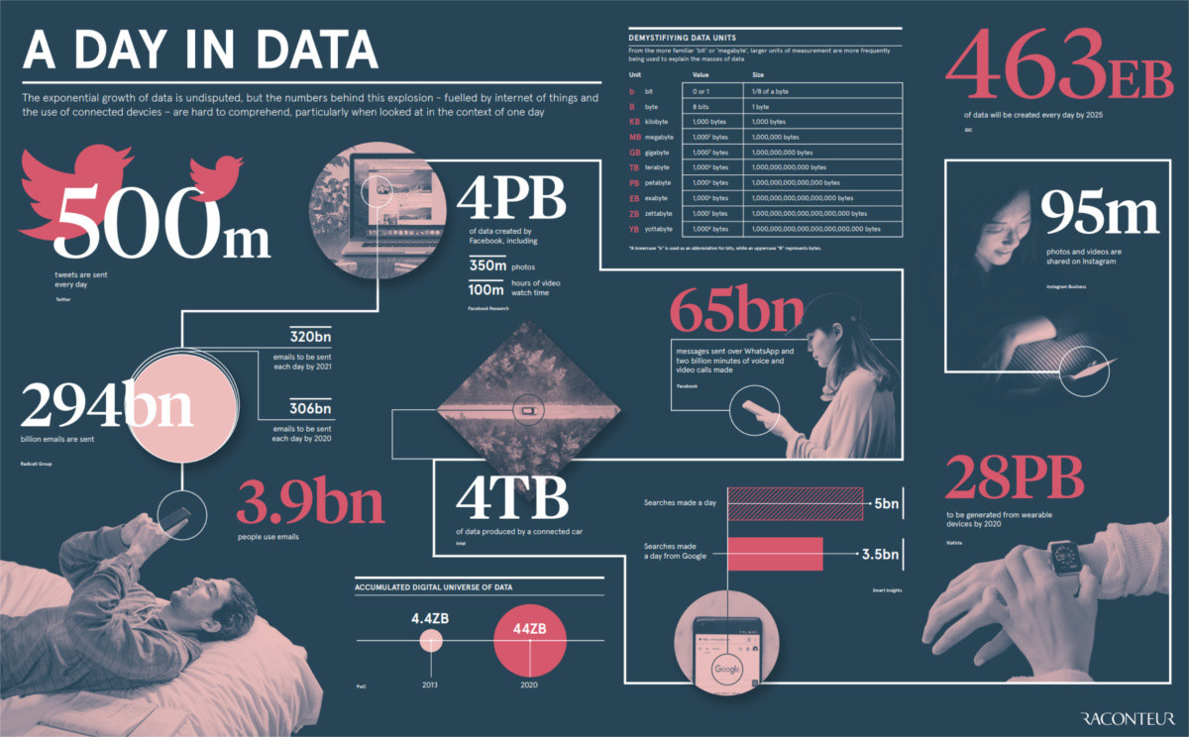
Data Analytics – The Context
‘the sexiest job in the world in the 21st century’
Notes:
Let me give you some context about data analytics.
Harvard University labeled Data analysts or Data Scientist as “the sexiest job of the 21st century.”
it seems like in these days everyone wants a Data Scientist, and for a good reason. according to LinkedIn, the career has seen an exponential growth and became the second fastest growing profession.
A huge amount of data is generated each day. But many companies are still facing obstacles when it comes to utilizing their data correctly, and some aren’t even sure of what to do with their data science teams.
Here’s a graph on a day in data. You can see that xxx, 4 perabyte data created on facebook.

Slide 8
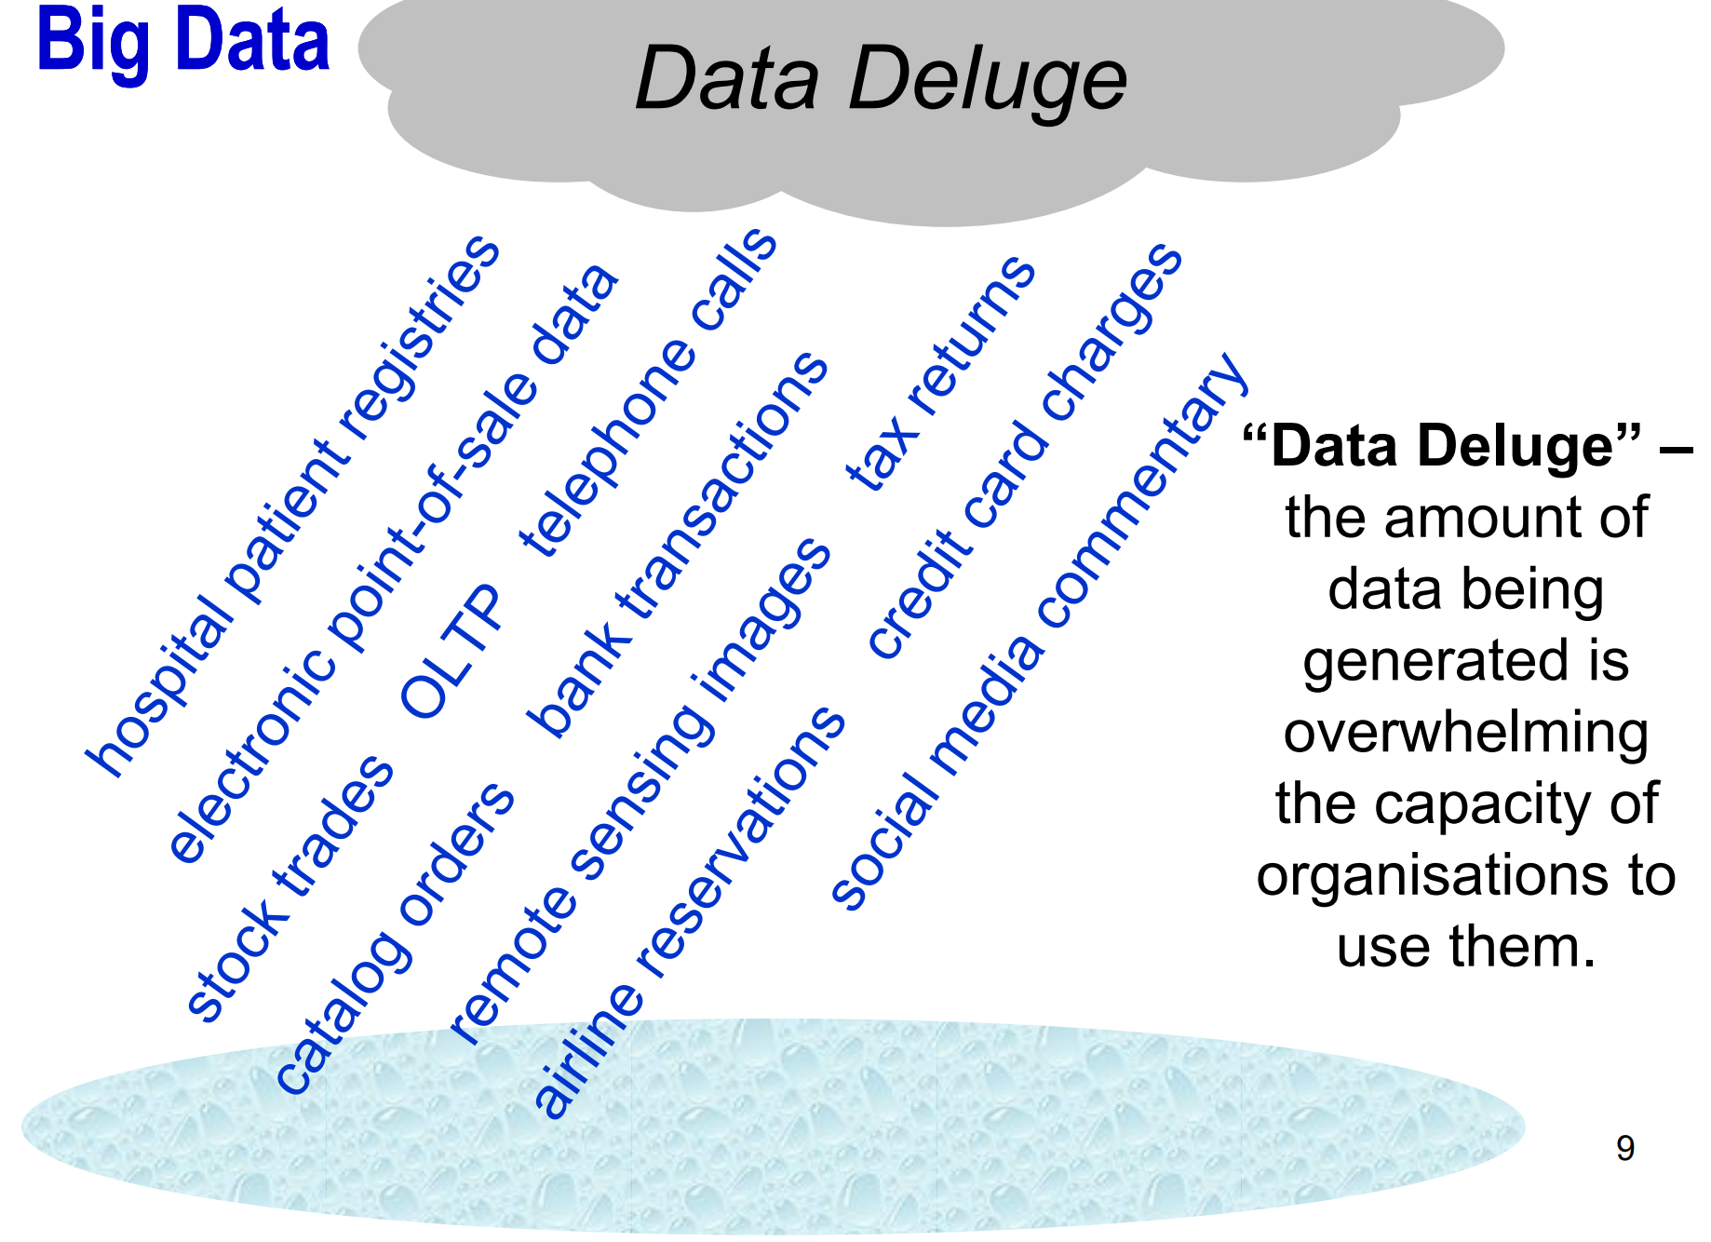
Big Data – Data Deluge
Notes:
In fact, the popular phrase big data is not an exaggeration. We are facing a real data deluge now, which means that xx.

Slide 9
Big Data – Data Deluge
Data + preparation + analytics = actionable knowledge
Notes:
And the organisations all know that the raw data itself is not a treasure. Only if data is attached with good preparation and proper analytics, it can then provide actionable knowledge, so that we can get insights or findings that we want.
The companies in real world, especially the big, international ones, put much effort in thinking about how to use data or provide more service around data. E.g. you may have heard of Google trends, some scholars use it to track the change of popularity of something that they want to study.
And also, digital banking, where you can find a personalised page or reports within the banks app in your cellphones
And Youtube analysis, many youtubers use it to see what kind of content will make them lose their audience so that they can avoid it next time,
And also, a typical example is Amazon recommendation. When you log into your amazon account, you can always see a lot of automatic recommendations for you that allure you to make the orders. They are all based on you past searches and purchases.
In some sense, we can say that the world nowadays is full of pitfalls. As your data is almost recorded every second, the businesses will collect the data, analyse them and then create more strategic presentations or products to attract your attention. And you find yourself spend more time and money on them.
And without doubts, this phenomenon going to be more and more severe in the following decades.

Slide 10
Big Data – Data Deluge
Data + preparation + analytics = actionable knowledge
Google Trends, digital banking, Youtube analysis,
Amazon recommendations…
Notes:
And the organisations all know that the raw data itself is not a treasure. Only if data is attached with good preparation and proper analytics, it can then provide actionable knowledge, so that we can get insights or findings that we want.
The companies in real world, especially the big, international ones, put much effort in thinking about how to use data or provide more service around data. E.g. you may have heard of Google trends, some scholars use it to track the change of popularity of something that they want to study.
And also, digital banking, where you can find a personalised page or reports within the banks app in your cellphones
And Youtube analysis, many youtubers use it to see what kind of content will make them lose their audience so that they can avoid it next time,
And also, a typical example is Amazon recommendation. When you log into your amazon account, you can always see a lot of automatic recommendations for you that allure you to make the orders. They are all based on you past searches and purchases.
In some sense, we can say that the world nowadays is full of pitfalls. As your data is almost recorded every second, the businesses will collect the data, analyse them and then create more strategic presentations or products to attract your attention. And you find yourself spend more time and money on them.
And without doubts, this phenomenon going to be more and more severe in the following decades.

Slide 11
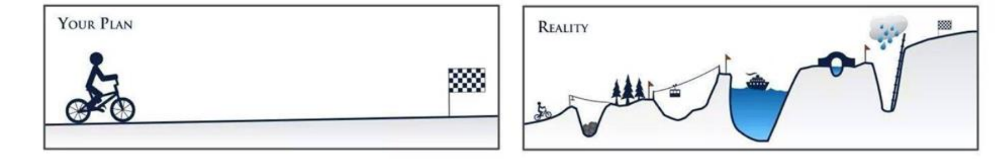
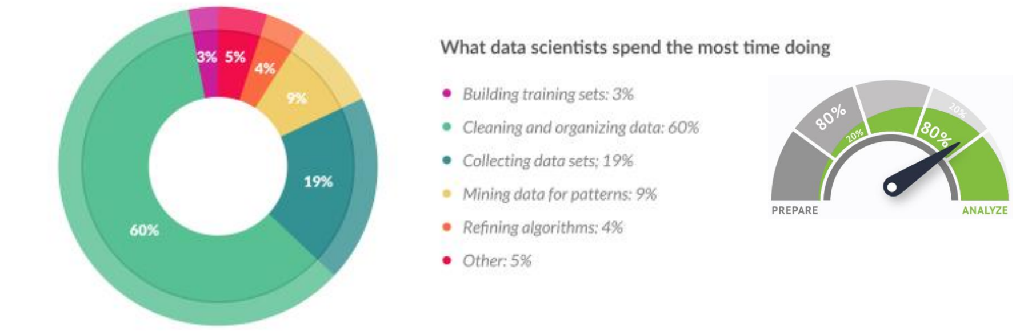
Data Analytics – The Reality
Data Analytics: Expectation vs. Reality
Forbes found that “Data preparation accounts for about 80% of the work of data scientists”
Notes:
Well. It should be minded that although all these applications sounds pretty direct and easy, there’s a big gap between the expectation and the reality of this work. I think this picture is a really good presentation. Real data analytics is full of challenges. And some challenges might be very time-consuming, or even be impossible to overcome.
Rather than developing the fancy algorithms or plot the eye-catching figures, much time and effort are spent on data collection and preparation. Forbes found that “Data preparation accounts for about 80% of the work of data scientists”. In particular, 19% is spent on collecting data sets and 69% is spent on cleaning and organising data. and other tasks like xx are very little in comparison.

Slide 12
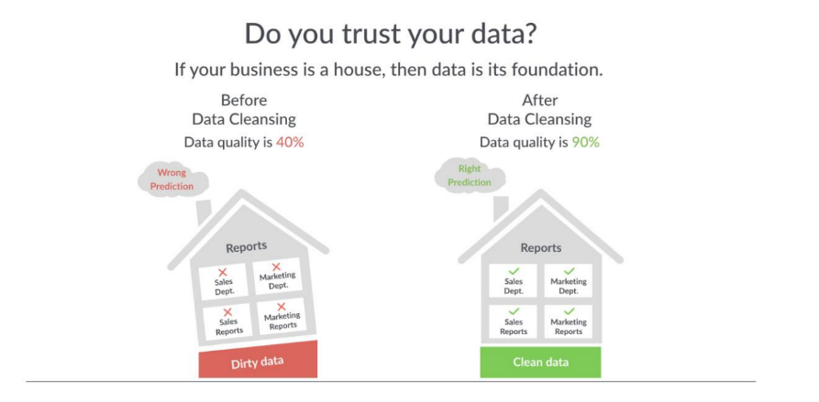
Data Preparation
Data preparation is crucial for getting meaningful results from data analytics.
Insufficiently prepared data leads to ‘Garbage in, Garbage out’ (GIGO)
Notes:
it is not unfair to say that Data preparation is crucial for getting meaningful results from data analytics.
Not enough time for satisfactory analytics upon pre-processed data
Insufficiently prepared data leads to ‘Garbage in, Garbage out’ (GIGO), a computer science acronym that implies bad input will result in bad output.
Which is the message of this picture. It says that if xxx.
So although data preprocessing may not appear in your research plan or in your methodology plan, please don’t forget or underestimate it. It is very crucial.

Slide 13
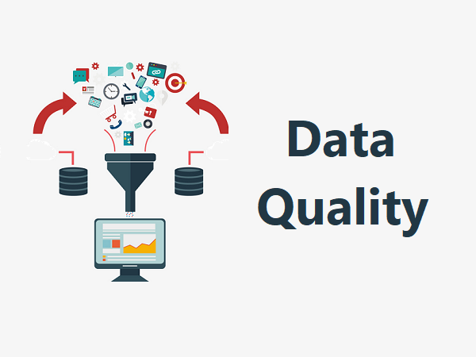
How to check data quality?
Meta data: “data about data”
Understanding data availability, types, quantity, complexity, etc.
Exploratory Data Analysis (EDA)
Analyzing data sets to summarize their main characteristics, often with visual methods.
Notes:
There are many ways to check the quality of your data. And here I’d like to cover 2 common ways.
One is to use Metadata. Meta data: “data about data”
The Motivation is to better understand the data, including its availability, types, quantity, complexity, among others.
Another is one Exploratory Data Analysis (EDA). EDA is widely used in data analytics and one of its functions is to check data quality. It is An approach to analyzing data sets to summarize their main characteristics, often with visual methods. EDA is primarily for seeing what the data can tell us before the formal modeling or hypothesis testing task
e.g. if I have sales at hand and I want to build a model to predict the performance of next month, then maybe I’ll start with EDA to do some random exploration, such as creating histograms to see whether there are any region stands out from the rest or if weekends have clear higher income.

Slide 14
Collecting Data Methods
Build private databases/data warehouses/etc.
Scrape from websites
From third-party platforms, e.g. Statista, World Bank, UKDS.
……
Notes:
Among others, the source of data is very crucial to determine the data quality from the very beginning
There are many ways to collect the data.
If you run your own business which generates data itself, then you might think about build a data warehouse to store the data and organise it as you wish, and the data can be easily retrieved when needed. But that usually costs a lot.
Or, you can scrape data from a website to collect the raw data yourself. that usually takes longer time to pre-process it as the data tends to be dirty. E.g. the price may be shown as a piece of text rather than a number as as you want. But the good point is that you can customise the data structure while collecting the data.
Alternatively, you can use the ready-made data sources. E.g.Statista which is usually for business data, and also World Bank, UKDS.

Slide 15
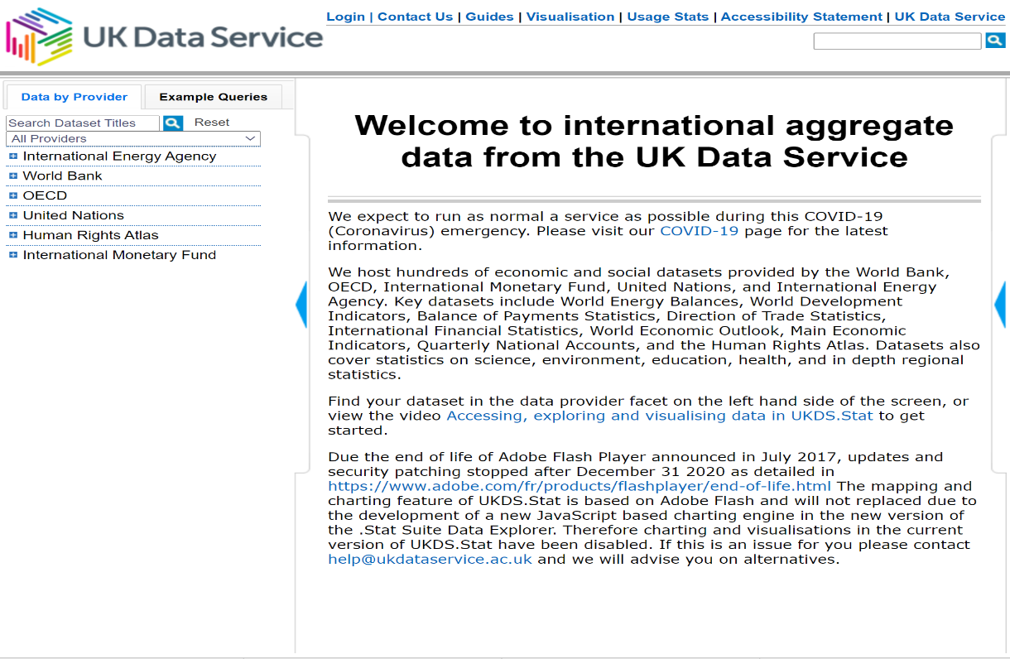
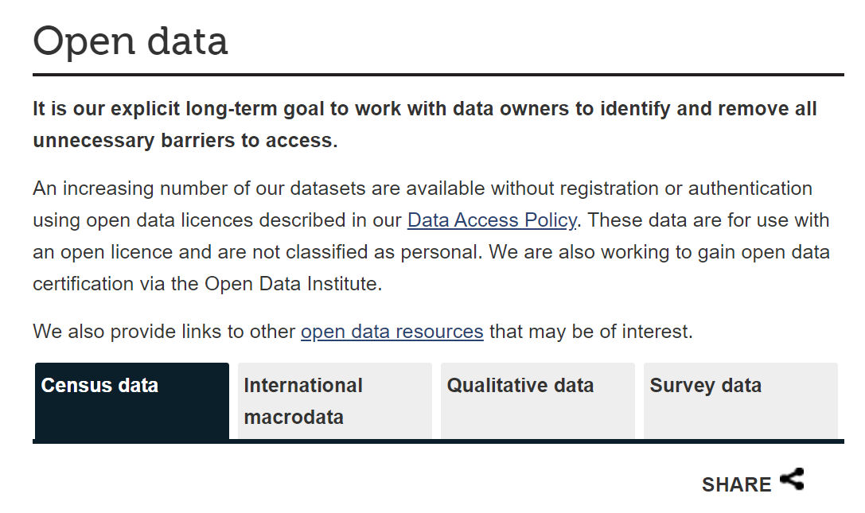
UKDS Website
Notes:
You can find a lot open source data on UKDS website, including xx.
you can also access data from other providers and use UKDS API to customise the layout as you want and then export the data.
The data is usually clean and this might save much time for data reduction or integration.
There are detailed instructions on how to access and use the data

Slide 16
Major Tasks in Data Pre-processing
Data integration - integration of multiple databases, data cubes, or files
Data description, summarisation and visualisation
Data cleaning - fill in missing values, smooth noisy data, identify or remove outliers and noisy data, and resolve inconsistencies
Data reduction - obtain reduced representation in volume but produces the same or similar analytical results
Data transformation - normalisation and aggregation
Data discretisation (for numerical data) and generalisation
Notes:
[pause]
So that’s it for the context and for collecting data.
And then you may ask again, what do we do in typical data preprocessing after we have the data at hand?
Major Tasks in Data Pre-processing includes xx

Slide 17
Major Tasks in Data Pre-processing
Data integration - integration of multiple databases, data cubes, or files
Data description, summarisation and visualisation
Data cleaning - fill in missing values, smooth noisy data, identify or remove outliers and noisy data, and resolve inconsistencies
Data reduction - obtain reduced representation in volume but produces the same or similar analytical results
Data transformation - normalisation and aggregation
Data discretisation (for numerical data) and generalisation
There’s no certain order of doing these steps!!
Notes:
Please bear in mind that xx. As I said there’s no recipe or standard atm for data preprocessing. All these tasks are just the most common ones. In fact, it’s quite often that you’ll have to repeat some of them multiple times. E.g. after reading the metadata, you clean the data to deal with null at the beginning. And then join the tables create new missing values, and clean it again.
In the rest of today’s session, I’m going to talk about the first entry, data integration. And for next Thursday I’m going to cover how to clean, reduce, and transform the data.

Slide 18
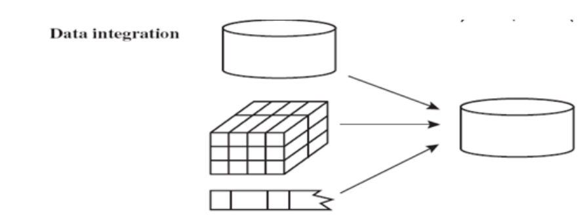
Data Integration
Data integration: combining data from multiple sources into a unified view
- To improve data quality
- To enrich data with additional information
- To allow reliable data analytics and beyond
Notes:
By definition, Data integration is combining data from multiple sources into a unified view. The benefits include:
- To improve data quality
- To enrich data with additional information
- To allow reliable data analytics and beyond
Data integration is kind of an unavoidable step to some extent. As it is not common that all information will be stored in one spreadsheet. For example, I have a dataset on hotel information, including name, city, star level, etc. which is very static
And another dataset of reservations, including customer, hotel name, payment method, price, etc. which is always updated.
and if I want to find which features of the hotel determine hotel’s popularity, then I’ll first need to link the two tables based on the hotel name, or hotel id

Slide 19
Data Integration
Data integration: combining data from multiple sources into a unified view
- To improve data quality
- To enrich data with additional information
- To allow reliable data analytics and beyond
Integrating in-house data within data warehouse together is relatively straightforward (with common attributes and structures across schemas).
Notes:
Usually, Integrating in-house data within data warehouse together is relatively straightforward (with common attributes and structures across schemas).
For example, joining the tables.

Slide 20
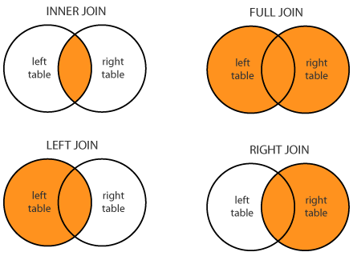
Manipulating Data - Joining
Joining tables:
Extract and simultaneously process data from more than one table.
Notes:
As the name indicates, Joining tables enable you to extract and simultaneously process data from more than one table.
There are four types of join, xx.
Notice that the methods are quite common in various applications and languages. So sql and python may have different joining commands, but you can always select which join you want to use
Also, remember to recheck data quality after the joining, as sometimes new missing values or unexpected rows might be created during the joining process.

Slide 21
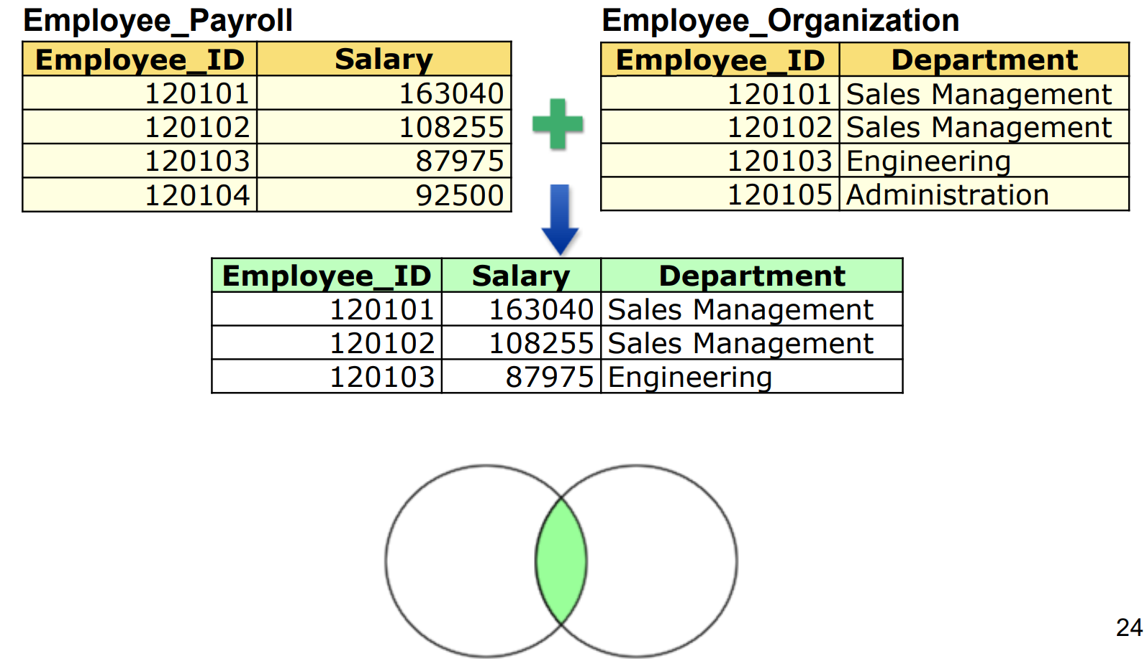
Manipulating Data – Join Types
By default, the joining query performs an inner join, which includes matching rows only in the results.

Slide 22
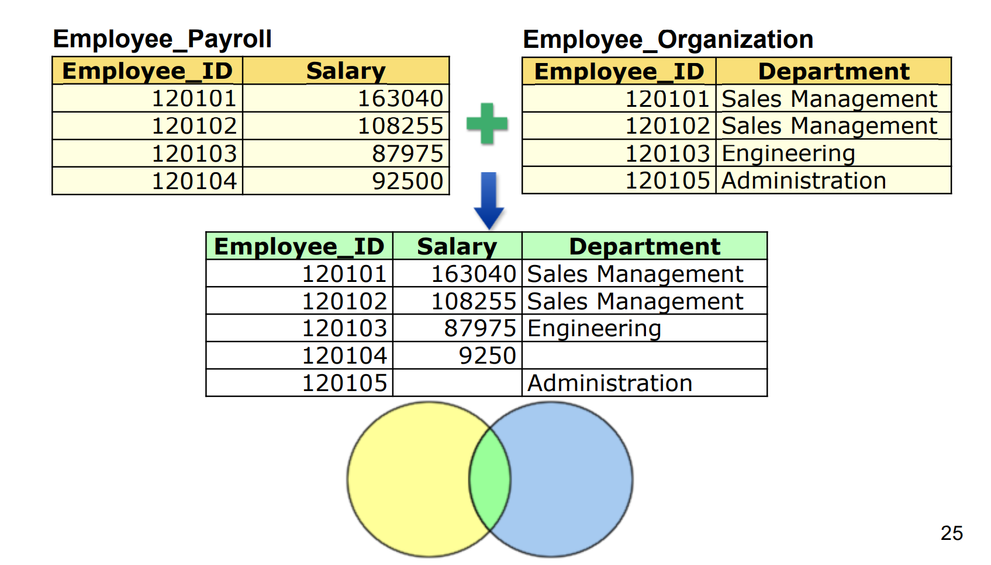
Manipulating Data – Join Types
A full outer join includes all rows from both tables.
92500

Slide 23
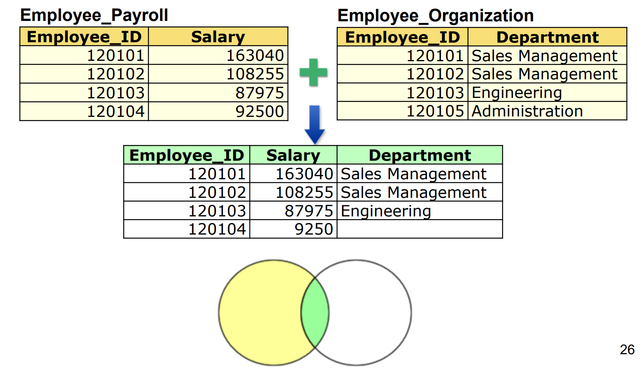
Manipulating Data – Join Types
A left join includes all rows from the left table.
92500
Notes:
This method is sensitive to the order of the table in the command. Be careful on which table you put first.

Slide 24

Difficulties of Integrating Data
Database heterogeneity
System Heterogeneity: different operating system, hardware platforms
Schematic or Structural Heterogeneity: the native model or structure to store data
Data value conflicts
E.g., metric vs. British units
Entity identification
E.g., Bill Clinton = William Clinton
Notes:
Data integration is not an easy job, as there are many difficulties.
First is Database heterogeneity, including System Heterogeneity and schematic heterogeneity.
System het occurs when using different operating system, hardware platforms
And Schematic or Structural Heterogeneity refers to cases where the native model or structure to store data differ in data sources, e.g SQL vs no SQL
The Second issue is about detecting and resolving data value conflicts.
For the same real-world entity, attribute values from different sources are different, including different representations, different scales, e.g., metric vs. British units
Last not least is on Entity identification.
When integrating data, we may need to identify entities from multiple data sources, but the same entity or attribute may have different names in different databases, e.g., Bill Clinton = William Clinton
We will discuss this later in data linkage

Slide 25
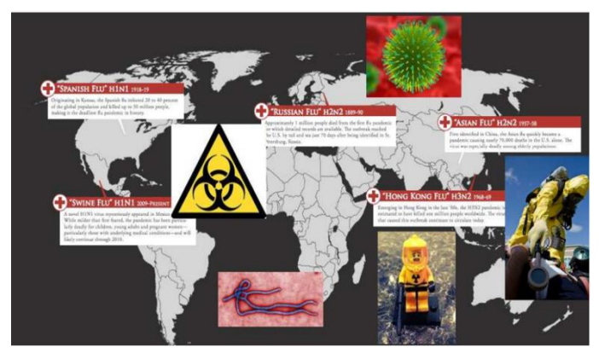
Example – Health Surveillance
Preventing the outbreak of epidemics requires monitoring of occurrences of unusual patterns of symptoms (in real time!)
Various databases
Many millions of records
Privacy and confidentiality concerns
Notes:
A vivid example is the health surveillance system which is very related to our situation now.
Preventing the outbreak of epidemics requires monitoring of occurrences of unusual patterns of symptoms (in real time!)
Data from many different sources need to be collected (including travel and immigration records; doctors, emergency and hospital admissions; drug purchases in pharmacies; animal health data; etc.)
Such databases can have different formats and codings, and they usually contain data of different quality
Volume is one issue, as they can contain many millions of records.
Also another issue is privacy and confidentiality, if such data are stored and linked at a central location and without proper regulations

Slide 26

Linking Data
Data linkage is the process of bringing together information from two different records that are believed to belong to the same entity based on matching variables.
Challenging if errors exists in the key variables
Notes:
Another two part of data integration is data linkage and data enrichment. They are relatively more complicated and not always need, so I won’t go deep into it. But I think it’s always good to know them in case you may encounter it in some days.
Data linkage is the process of bringing together information from two different records that are believed to belong to the same entity based on matching variables. It is also known as record linkage, data matching, entity identification, etc.
It is a challenging task if there are errors in the key variables that are used to link the data

Slide 27
Linking Data
Deterministic linkage
Agree exactly on the key, e.g. ID number
Probabilistic linkage
Frequency analysis of data values.
Notes:
There are two kinds of linkage.
First is Deterministic linkage
Records must agree exactly on the key attributes in order to conclude that they correspond to the same entity
It can be used when a high-quality identifier such as ID numbers are available
Another kind is Probabilistic linkage
It does NOT require that all key variables match.
Rather, it involves frequency analysis of data values, which helps to calculate a weight that indicates how likely that two fields refer to the same entity.
Sometimes, there are some Uncommon value agreement, or very strong evidence for linkage. Then they need to be included into consideration manually.

Slide 28
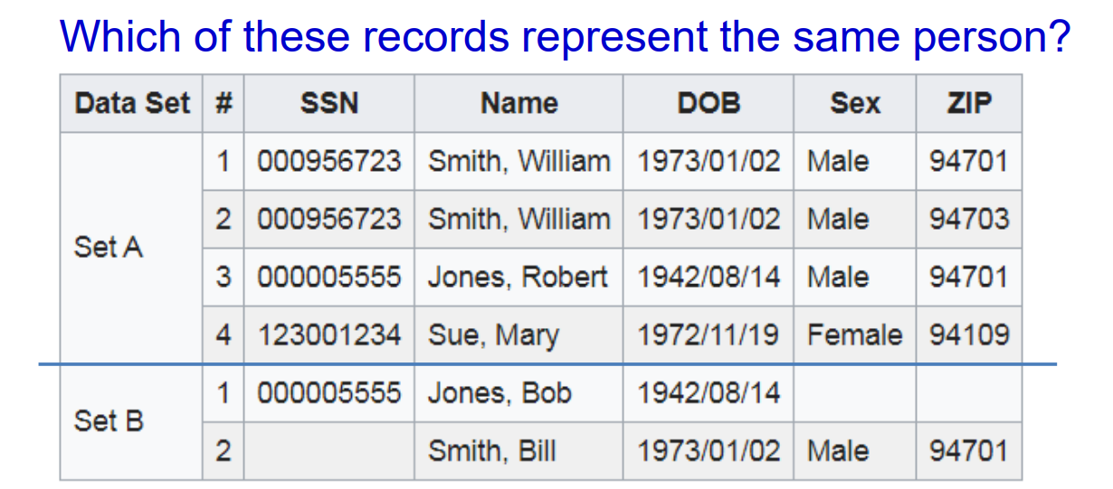
Linking Data
Notes:
e.g.
Based on Deterministic linkage, we can set SSN as the reference. Row 1 in set B will be assigned to Row 3 in set A. But Row 2 in set B will fail to find a match.
And if adopting Probabilistic linkage, we need find row 2 in set B is a replication of row 1 in set A, as they share same DOB, Sex and ZIP, although the name is name is not exactly the same.

Slide 29
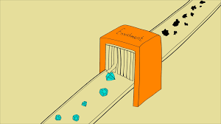
Enriching Data
Data enrichment: the process of introducing more data
Disparate data from other internal sources or third-party data from external sources
Provide contextualization with additional data
Help enrich or validate the data
Notes:
Data enrichment is the process of introducing more data.
It can be disparate data from other internal sources, or third party data from external sources.
The benefits is that, first, it can provide contextualization with additional data, and second, it helps enrich or validate our data
For example: to get a better understanding of advertising effectiveness, a company can enrich internal sales data with third party advertisement data
Enriched data is a valuable asset for any organization because it becomes more useful and insightful.
A majority of brands conduct data enrichment on their raw data so that they can use it to make informed decisions. In 2018, data enrichment grew by 80%

Slide 30
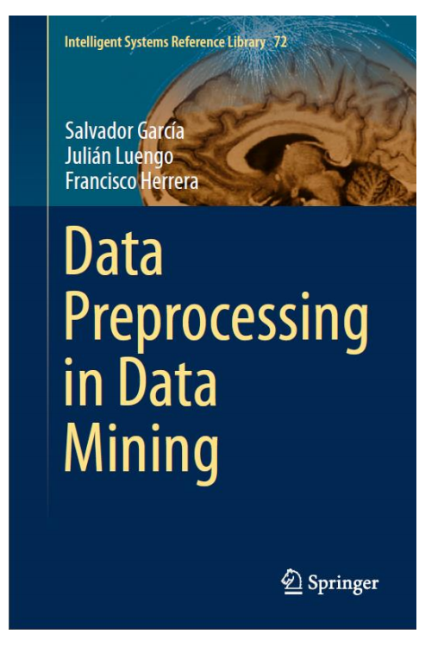
Acknowledgement
Some of the content is based on …
García, S., Luengo, J. and Herrera, F., 2015. Data preprocessing in data mining (pp. 59-139). New York: Springer.)

Slide 31
You might be interested in...
Upcoming events:
Data Pre-processing: Clean, Reduce, Transform, on 1pm Jan 21
Online workshop: Data Pre-processing Methods in Python, on 1pm Jan28
Online workshop: Techniques and Methods of Analysis for Social Network Data, on 2pm Jan 27
UK Data Service Computational Social Science Drop-in, on 1pm Feb 9
Recent events:
Text-mining series
Social Network Analysis series
Data in the spotlight: UK and cross-national surveys
Notes:
Before we get into the q and a part, I just want to draw your attention to some upcoming events that you might find useful, such as: xxx
We have also held events on xx
You can also find our past events on UK Data service website and youtube channel.

Slide 32


Questions
Anran Zhao
anran.zhao@manchester.ac.uk
UKDS
@UKDataService
UKDataService

